Slide 1
Weekly Report
Wensheng Cheng
2022.2.21-3.7

Slide 2
Last discussion
No use QG-RPN(baseline), try to combine RPN(coco) with correlation based heatmap. RPN extracts objects, and heatmap chooses those similar with the template.
Can RPN(coco) extract all target objects?
Conclusion: basically yes, it can find target objects which QG-RPN(baseline) cannot find, but many FP are introduced.
How to combine RPN with heatmap?
Ans: multiply the heatmap with the cls_score of RPN output, and scale limitation can also be used.
Conclusion: it could remove some FP, but current heatmap itself is not good enough, so the process still needs improvement.

Slide 3
This week
No use heatmap in RPN process, since it’s not precise enough. Use it in the RPN stage would miss TPs. We can use template appearance feature after RPN stage.
How is the effect of scale limitation?
Conclusion: necessary, it can effectively remove objects much larger than our template.
How is the feature discriminative ability of RPN model(COCO)?
Conclusion: not very good, for complex scenes with many foreground objects, the similarity between some FPs and the template could be higher than that between TP and the template.
Thought: try to use ImageNet classification model to extract feature.

Slide 4
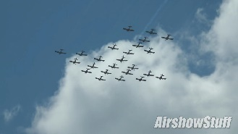
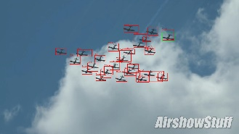
Pipeline
FPN
RPN
Classification
Regression
Temp Box
Filter
X,Y,W,H
Scale Limit
Appearance
Input
Output

Slide 5
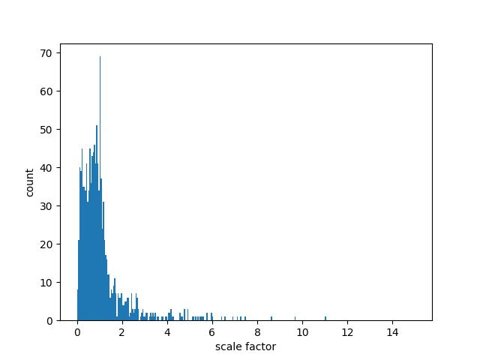
Use Scale as Limitation
After calculating the box area ratio in the 1st image of al sequences, we set the proposal_area/temp_area to (0,4).

Slide 6
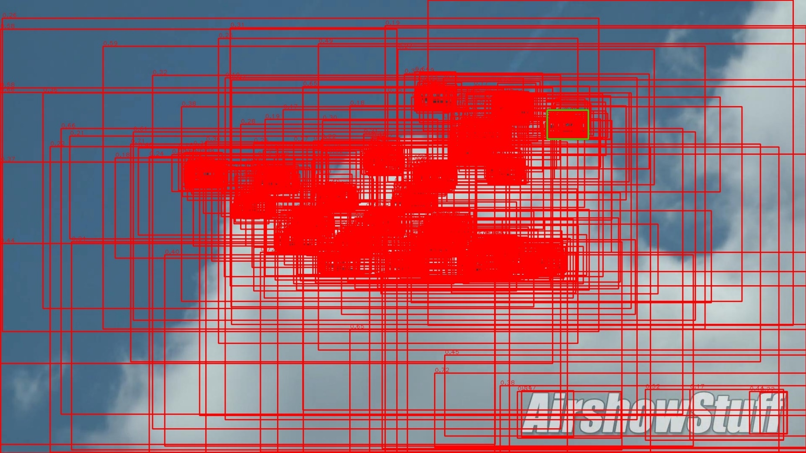
Before Scale Limitation
RPN proposals before scale limitation (rpn_proposal\ori_standard_nms_th_07).

Slide 7
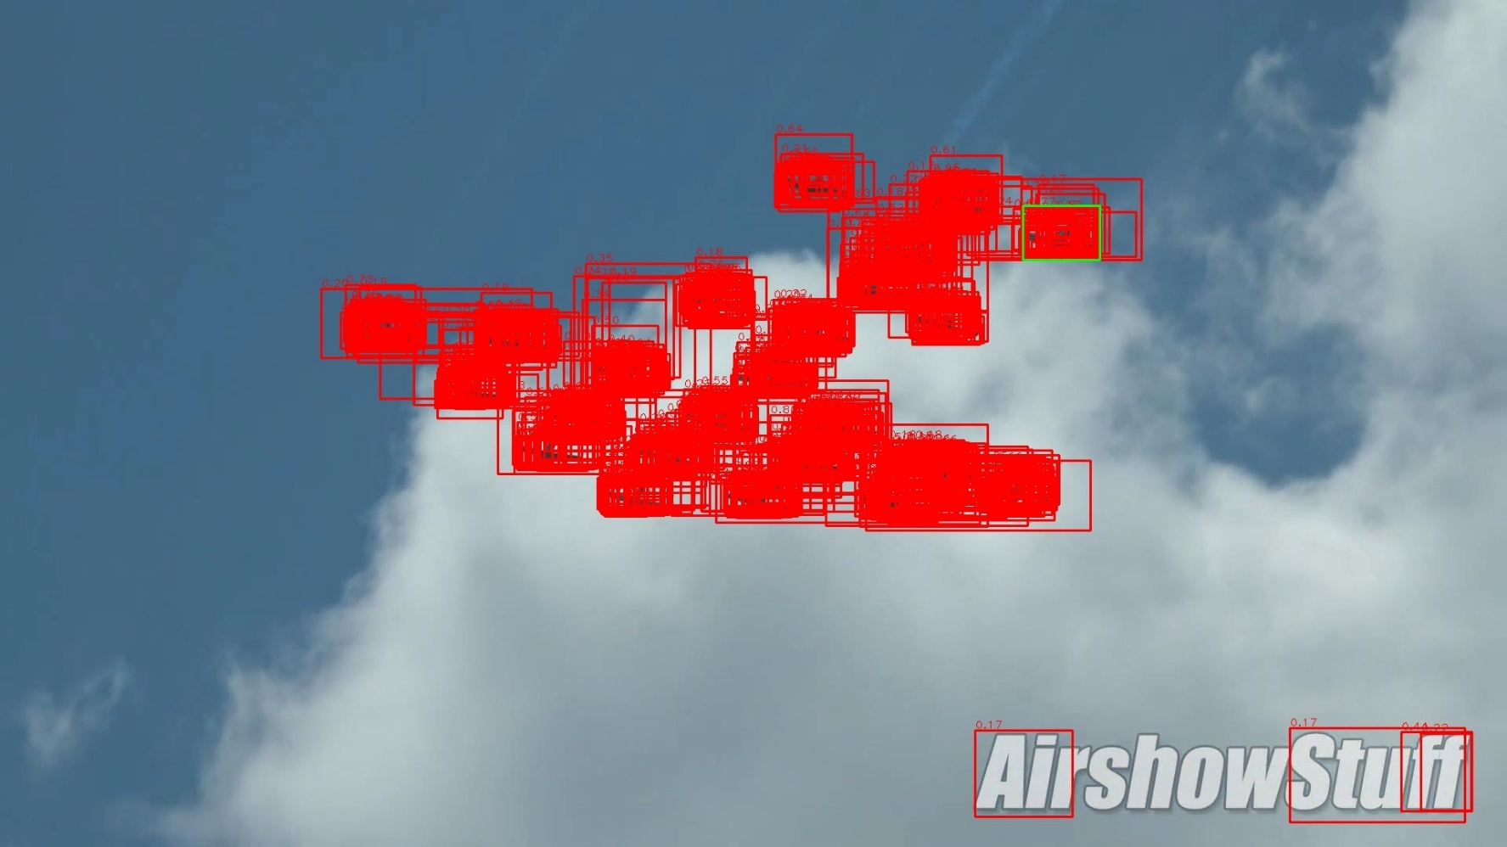
After Scale Limitation
RPN proposals after scale limitation (rpn_proposal\post_process\from_stand_nms_th_07\scale_00_40\no_post_process).

Slide 8
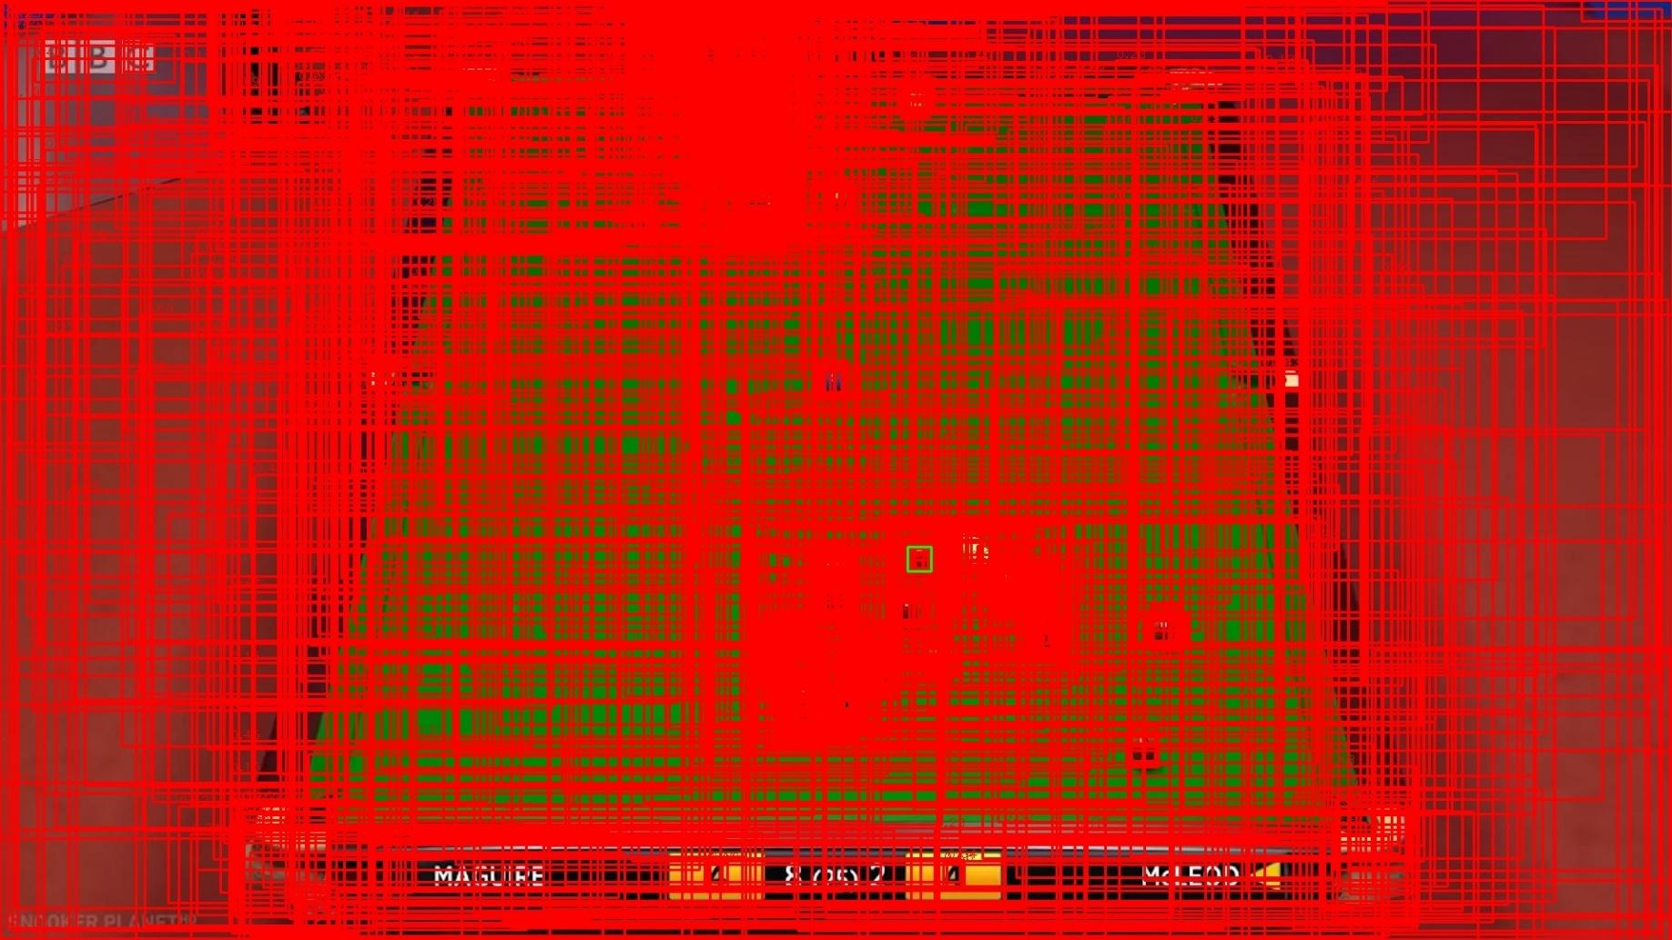
Before Scale Limitation
RPN proposals before scale limitation (rpn_proposal\ori_standard_nms_th_07).

Slide 9
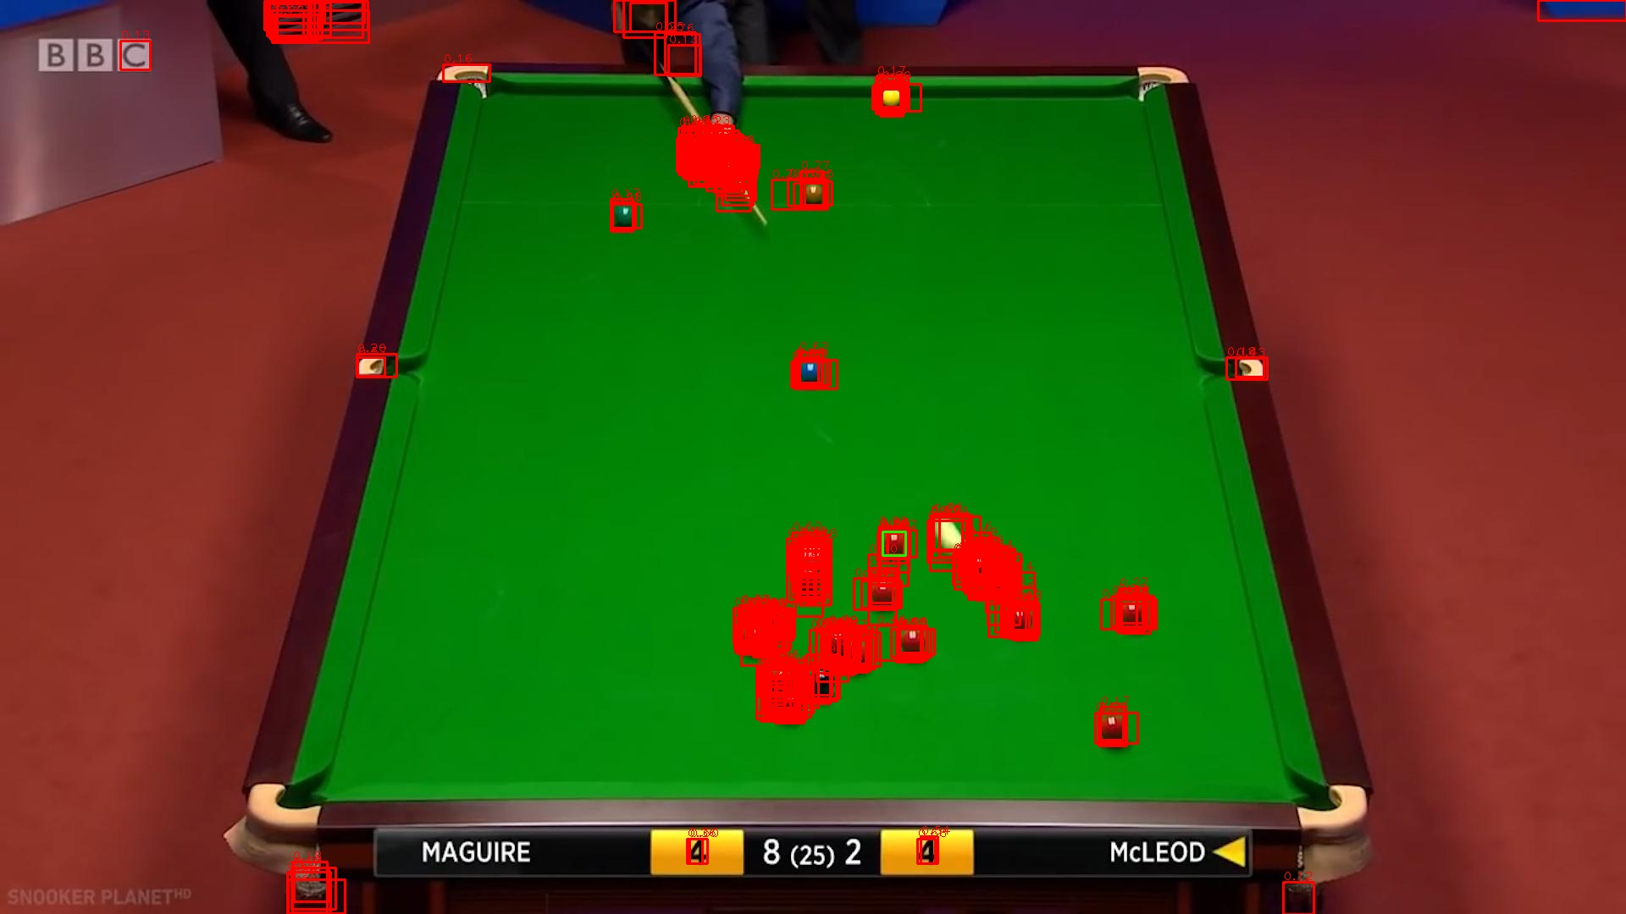
After Scale Limitation
RPN proposals after scale limitation (rpn_proposal\post_process\from_stand_nms_th_07\scale_00_40\no_post_process).

Slide 10
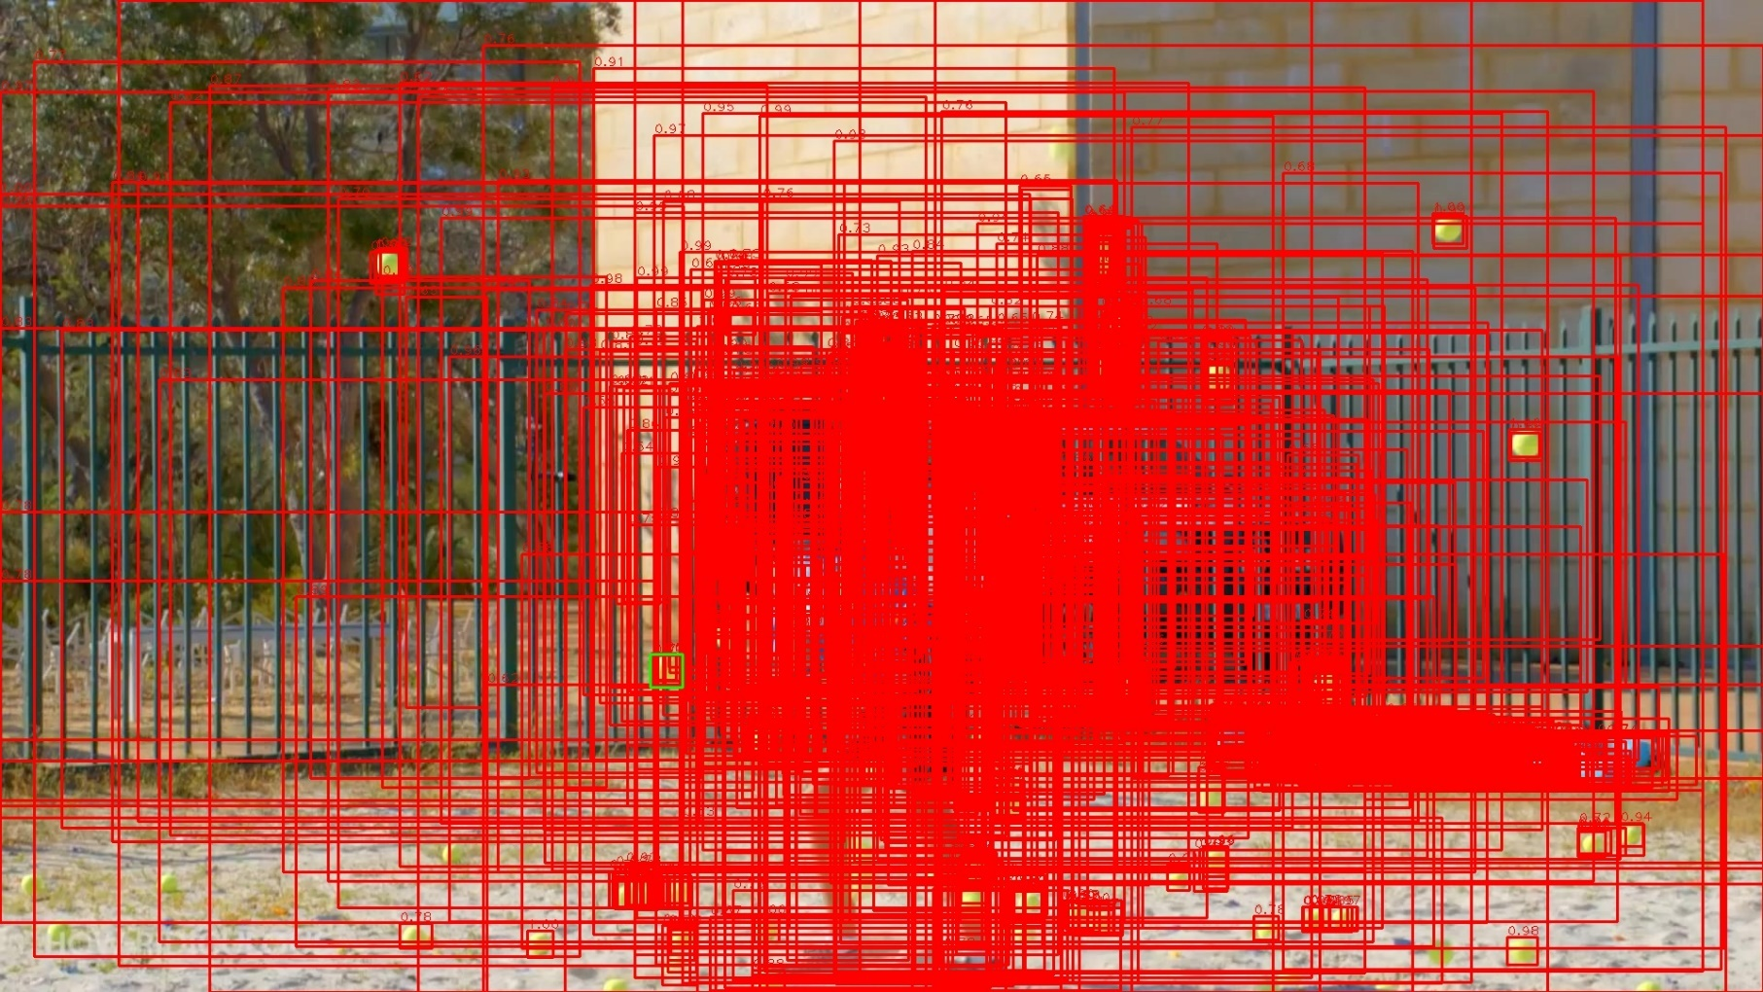
Before Scale Limitation
RPN proposals before scale limitation (rpn_proposal\ori_standard_nms_th_07).

Slide 11
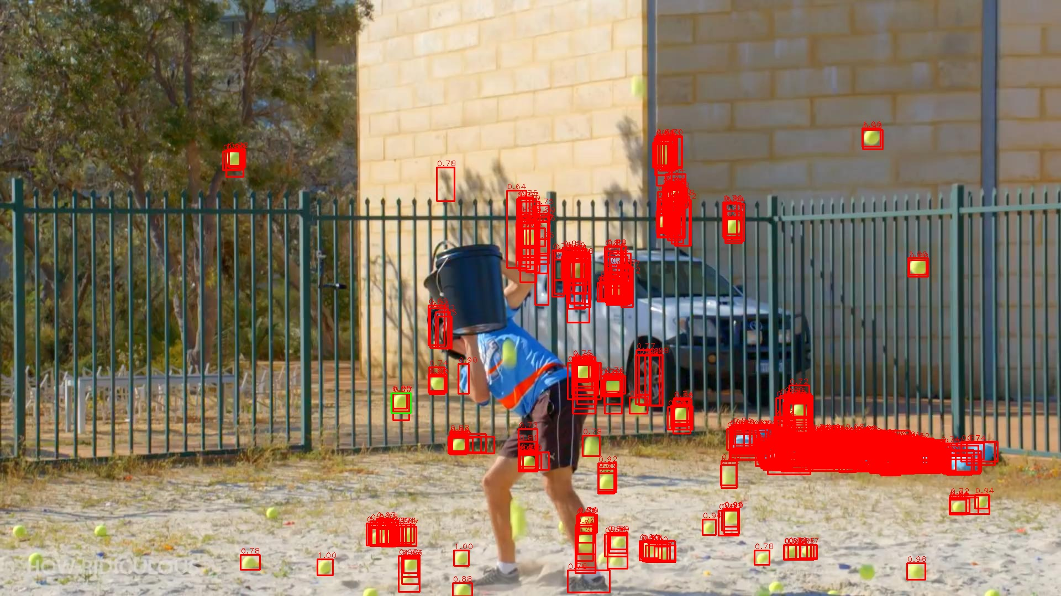
After Scale Limitation
RPN proposals after scale limitation (rpn_proposal\post_process\from_stand_nms_th_07\scale_00_40\no_post_process).

Slide 12
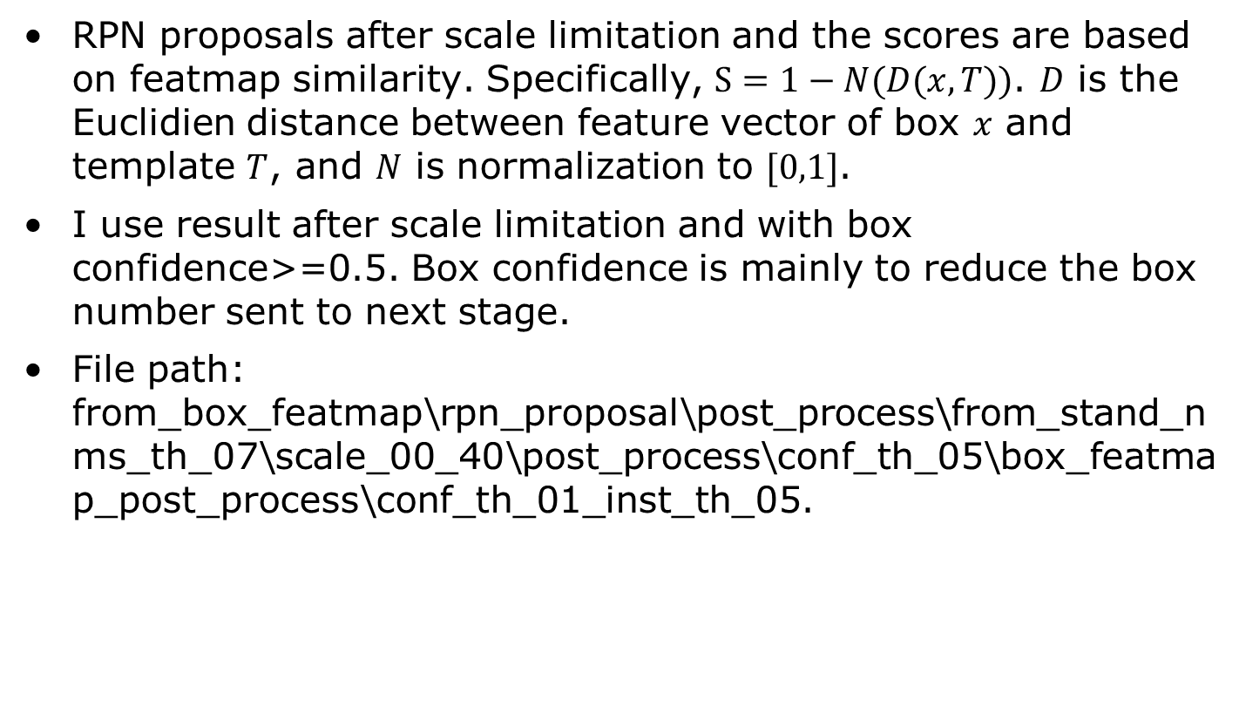
Use Featmap Similarity
RPN proposals after scale limitation and the scores are based on featmap similarity. Specifically, $S=1−N(D(x,T))$. $D$ is the Euclidien distance between feature vector of box $x$ and template $T$, and $N$ is normalization to $[0,1]$.
I use result after scale limitation and with box confidence>=0.5. Box confidence is mainly to reduce the box number sent to next stage.
File path: from_box_featmap\rpn_proposal\post_process\from_stand_nms_th_07\scale_00_40\post_process\conf_th_05\box_featmap_post_process\conf_th_01_inst_th_05.

Slide 13
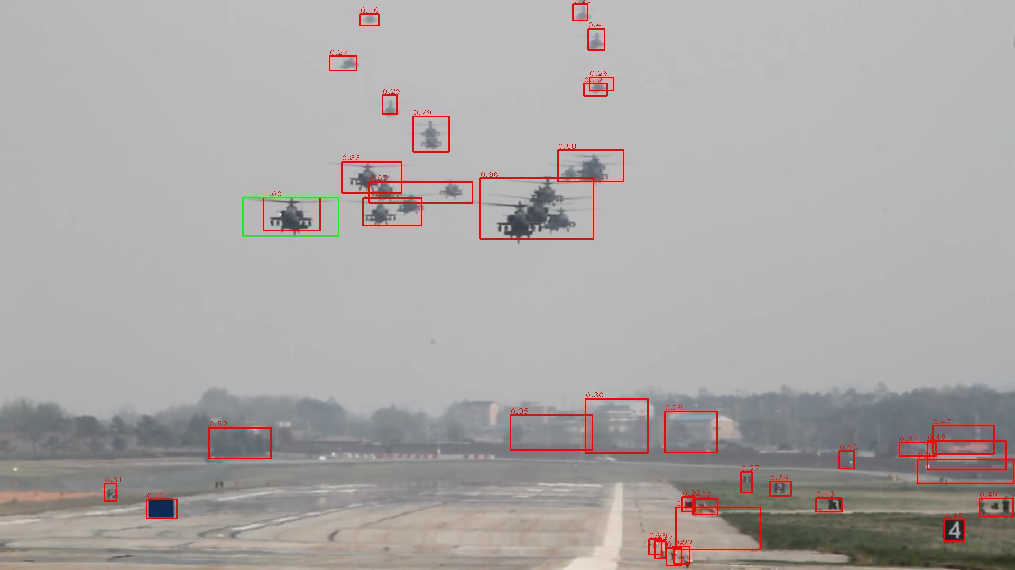
Use Featmap Similarity

Slide 14
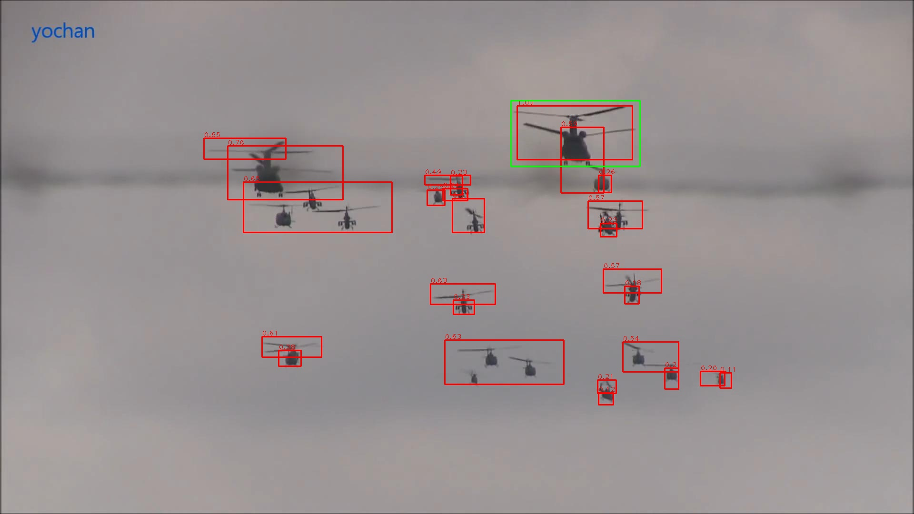
Use Featmap Similarity

Slide 15

Use Featmap Similarity

Slide 16
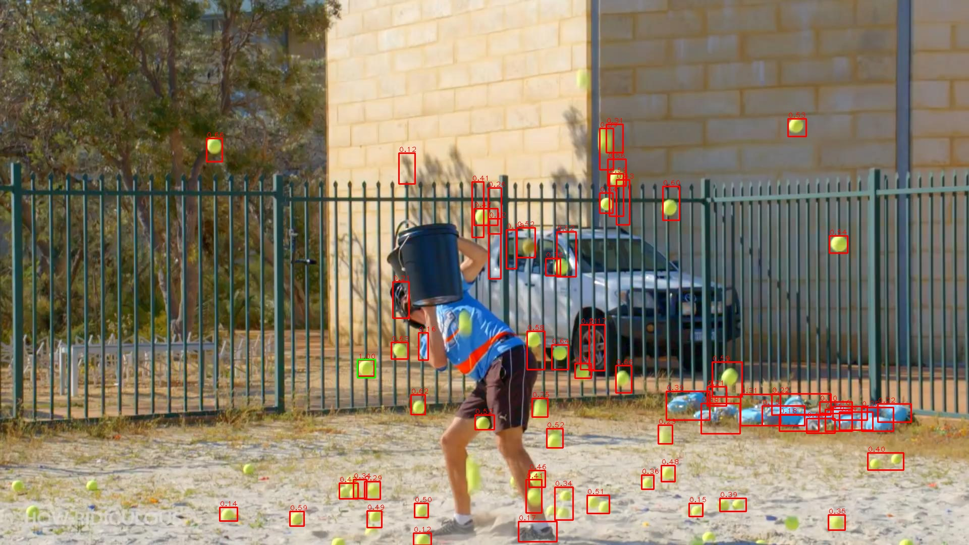
Use Featmap Similarity

Slide 17
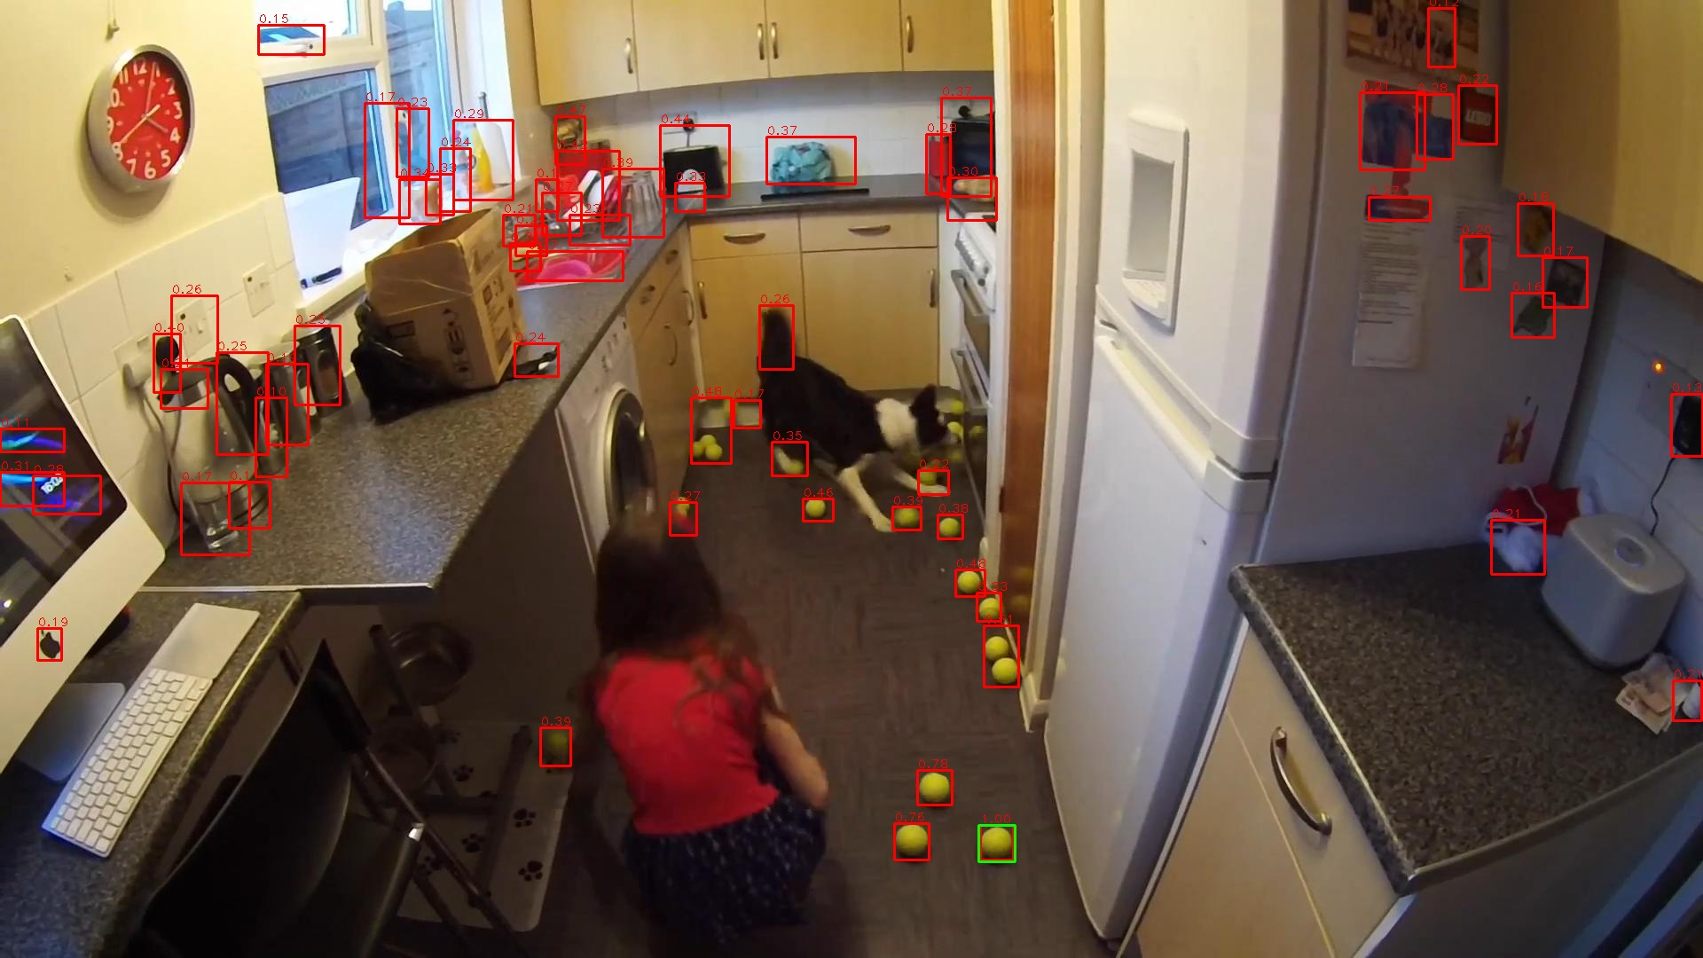
Use Featmap Similarity

Slide 18
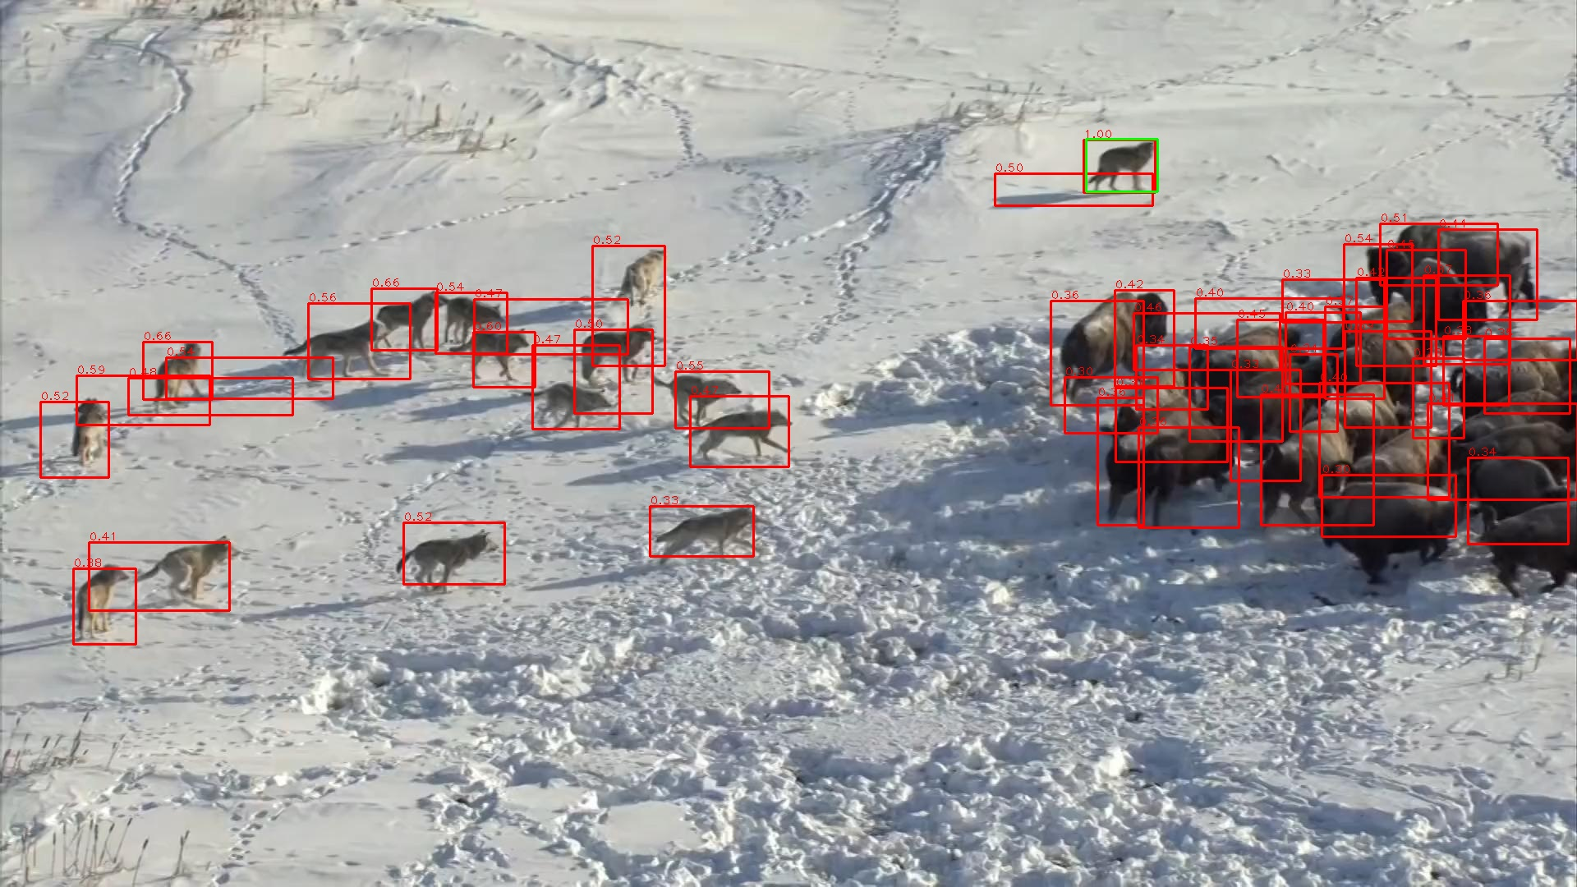
Use Featmap Similarity

Slide 19
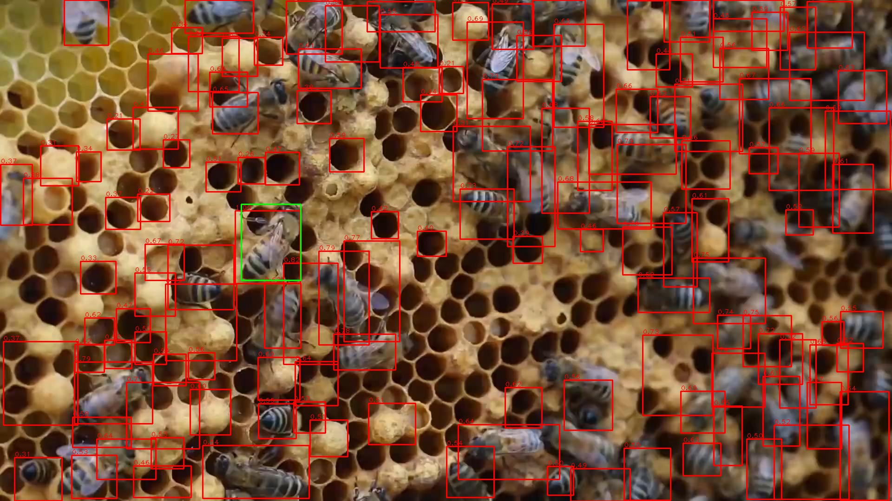
Use Featmap Similarity

Slide 20
End
End and Thanks!

